Slide 1
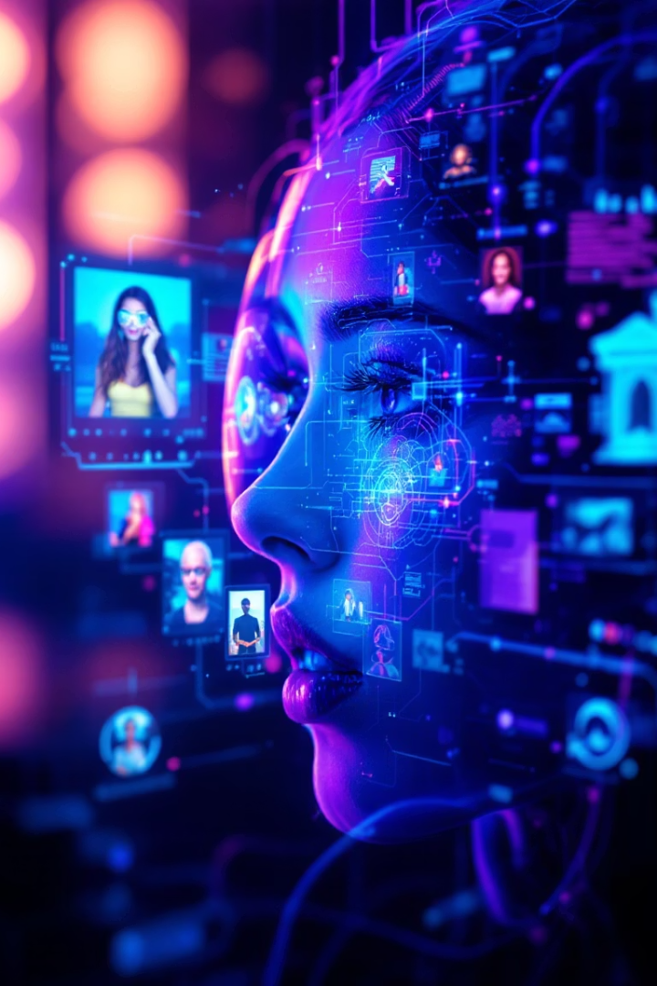

Deep Learning Applications: A Personal Exploration into Computer Vision
Final Project – Spring 2025 Advanced Machine Learning
Name: Sanjar Turaev Student ID: 811360569 Email: sturaev@kent.edu
ST
Notes:
Hello everyone, my name is Sanjar Turaev, and today I’ll be presenting my final project for Advanced Machine Learning. The topic I chose is Deep Learning Applications: A Personal Exploration into Computer Vision. Over the next 15 minutes, I’ll walk you through how computer vision evolved, where it’s being used today, the challenges it faces, and what the future might look like."

Slide 2
Deep Learning Applications: A Personal Exploration into Computer Vision
Computer vision represents a fascinating frontier in deep learning, teaching machines to "see" and interpret the world as humans do. This technology has become ubiquitous in our daily lives from facial recognition and self-driving cars to medical diagnostics and social media filters.
At the core of computer vision's advancement are Convolutional Neural Networks (CNNs), which revolutionized the field by automatically learning visual patterns. More recently, Vision Transformers (ViTs) have emerged, treating images as sequences of patches similar to how language models process text.
This presentation explores the evolution, current applications, and future potential of computer vision technology across various industries, highlighting both its remarkable capabilities and persistent challenges.
Notes:
Computer vision is a fascinating branch of deep learning where we teach machines to see and interpret the world like humans do. It’s not just something futuristic — it's already everywhere in our daily lives: from facial recognition on our phones to self-driving cars and even medical diagnostics.
At the heart of modern computer vision are Convolutional Neural Networks, or CNNs, which learn to detect patterns automatically. More recently, Vision Transformers, or ViTs, have emerged, treating images more like sequences of text, allowing better global understanding.
In this presentation, I’ll explore the evolution, real-world applications, and future potential of this incredible technology.

Slide 3
The Evolution of Computer Vision
Traditional CV
Vision Transformers
Early models relied on manually designed features like edges or corners, requiring significant human intervention.
ViTs emerged as alternatives to CNNs, treating images as sequences of patches for better relationship modeling.
1
2
3
4
CNN Revolution
Self-Supervised Learning
AlexNet's 2012 ImageNet victory marked a turning point, with CNNs like VGGNet and ResNet following.
Methods like SimCLR, MoCo, and DINO now allow models to learn from unlabeled data.
Despite these advances, deep learning models still face significant challenges. They remain vulnerable to adversarial examples, struggle with generalization to new situations, and often function as "black boxes" with limited interpretability. Researchers are actively developing techniques to make models more robust, transparent, and efficient.
Notes:
The story of computer vision can be divided into four key stages:
First, Traditional Computer Vision relied heavily on hand-crafted features. Engineers had to manually define edges or textures for models to recognize. It worked, but it was time-consuming and limited.
Then came the CNN Revolution. In 2012, AlexNet shocked the world by winning the ImageNet competition. It proved that deep learning could outperform traditional methods by a huge margin. Models like VGGNet and ResNet followed, improving accuracy even further.
Later, Vision Transformers introduced a totally different approach. Instead of using convolutions, they broke images into patches and processed them more globally — leading to new state-of-the-art results.
Finally, Self-Supervised Learning appeared. Methods like SimCLR and MoCo now allow models to learn without needing millions of labeled images, reducing the heavy dependence on manual labeling.

Slide 4
Computer Vision in Healthcare
Medical Imaging Analysis
Case Prioritization
Digital Pathology
AI tools from companies like Aidoc and Zebra Medical Vision analyze X-rays, CT scans, and MRIs to detect diseases such as cancer, pneumonia, or brain hemorrhages—sometimes with greater accuracy than human doctors.
Computer vision systems help medical professionals identify urgent cases, saving critical time in emergency situations where minutes can mean the difference between life and death.
AI systems assist pathologists by examining tissue samples for abnormalities, potentially catching subtle signs of disease that might be missed in manual examination.
The integration of computer vision in healthcare represents one of the most promising applications of this technology, with the potential to improve diagnostic accuracy, reduce physician workload, and ultimately save lives through earlier detection of serious conditions.
Notes:
Healthcare is one of the most exciting areas where computer vision is making a real impact.
AI tools from companies like Aidoc and Zebra Medical Vision are helping analyze X-rays, CT scans, and MRIs to detect diseases like cancer or brain hemorrhages — often matching or even exceeding human doctor accuracy.
Beyond diagnosis, computer vision helps prioritize urgent cases, saving critical minutes in emergency rooms. It’s also being used in digital pathology, helping pathologists catch subtle signs of disease that could otherwise be missed.
Overall, the integration of computer vision into healthcare is not just about efficiency — it’s about saving lives.

Slide 5




Transportation and Autonomous Vehicles
Environmental Perception
Self-driving vehicles from Tesla, Waymo, and Cruise use computer vision to identify other vehicles, pedestrians, traffic signs, and lane markings.
Advanced Driver Assistance
Modern cars incorporate ADAS features like automatic emergency braking and lane-keeping assistance, enhancing safety even in human-driven vehicles.
Navigation and Mapping
Computer vision helps create and update detailed maps, recognizing changes in road conditions and infrastructure in real-time.
Traffic Management
Smart city infrastructure uses computer vision to optimize traffic flow, reduce congestion, and improve urban mobility.
While autonomous vehicles represent one of the most visible applications of computer vision, the technology faces significant challenges in ensuring reliability across diverse weather conditions, unpredictable human behavior, and rare edge cases that could compromise safety.
Notes:
Another major area is transportation, especially autonomous vehicles.
Companies like Tesla, Waymo, and Cruise use computer vision for environmental perception — detecting other cars, pedestrians, signs, and even changing road conditions.
In addition, even traditional vehicles use vision-based Advanced Driver Assistance Systems, like lane keeping and automatic braking, to improve safety.
Vision systems also help with real-time mapping and traffic management, creating smarter and safer cities.
However, autonomous driving still faces big challenges — like handling unpredictable human behavior, bad weather, and rare events that are hard for AI to predict.

Slide 6








Security, Retail, and Manufacturing Applications
Security & Surveillance
Retail Innovation
Facial recognition technology is used in airports and border security, while AI video analytics can detect suspicious behavior, count people, and monitor social distancing.
Computer vision powers inventory management, cashier-less stores like Amazon Go, customer tracking, and personalized marketing based on visual data.
Aerial Applications
Manufacturing
Drones equipped with computer vision inspect infrastructure, monitor crop health in agriculture, and assist in disaster response efforts.
AI vision systems perform quality control inspections faster and more consistently than humans, reducing waste and improving production efficiency.
While these applications demonstrate computer vision's versatility, they also raise important concerns about data privacy, potential bias in facial recognition systems, and the accessibility of this technology for smaller businesses with limited resources.
Notes:
Computer vision is transforming many industries beyond healthcare and transportation.
In security and surveillance, AI is used for facial recognition at airports and detecting suspicious behavior in crowds.
In retail, companies like Amazon use computer vision for cashier-less stores, inventory tracking, and personalized customer experiences.
In manufacturing, AI vision systems inspect products for defects faster and more consistently than humans, improving quality and reducing waste.
We even see aerial applications — drones using computer vision to monitor crops, inspect infrastructure, and assist in disaster response.
But along with these benefits come ethical concerns, like privacy, bias in facial recognition, and making sure small businesses can access these technologies fairly.

Slide 7










Challenges in Computer Vision
Data Dependency
Models require massive labeled datasets
Robustness Issues
Vulnerable to adversarial attacks
Limited Explainability
Most models function as "black boxes"
Energy Consumption
Training requires significant computing resources
Ethical Concerns
Privacy, bias, and surveillance issues
Despite impressive advances, computer vision still faces significant hurdles. The field's reliance on massive datasets creates barriers for smaller organizations, while the vulnerability to subtle image manipulations raises safety concerns for critical applications. The "black box" nature of many models limits trust and accountability, and the environmental impact of training large models remains substantial.
Notes:
Despite the incredible progress, computer vision still faces serious challenges:
First, models need massive amounts of labeled data, creating barriers for smaller organizations.
Second, they are vulnerable to adversarial attacks — tiny image changes that can fool a system completely.
Third, limited explainability makes it hard to trust AI decisions because many models operate as black boxes.
Fourth, energy consumption is a growing concern — training large models uses a lot of computing power.
And finally, ethical concerns like surveillance and bias must be addressed carefully as this technology becomes more powerful.

Slide 8




Future Developments in Computer Vision
Few-Shot Learning
Models that learn from limited examples
Explainable AI
Transparent decision-making processes
Efficient Computing
Lower energy consumption and mobile deployment
Multimodal Integration
Combining vision with other senses and reasoning
The future of computer vision lies in overcoming current limitations. Self-supervised and few-shot learning approaches promise to reduce data requirements, making the technology more accessible. Advances in explainable AI will help users understand and trust model decisions. More efficient architectures and techniques like model pruning will reduce environmental impact, while integration with other AI domains will create more holistic understanding systems.
Notes:
Looking forward, the future of computer vision is full of possibilities:
Few-shot learning will allow models to learn from just a handful of examples, making AI more accessible.
Explainable AI aims to make decisions more transparent and trustworthy.
Efficient computing will help models use less energy and run on mobile devices.
And multimodal integration will combine vision with other senses like sound or touch, creating smarter, more human-like systems.
These advancements promise to make computer vision more powerful, responsible, and accessible.

Slide 9
Conclusion: Bridging Machines and the Human World
2012
16x16
4+
CNN Breakthrough
ViT Innovation
Major Industries
AlexNet revolutionized the field
Image patches in Vision Transformers
Healthcare, transport, security, retail
Computer vision has evolved from an academic curiosity to a transformative technology reshaping industries and daily life. The journey from CNNs to Vision Transformers represents remarkable progress, yet significant challenges remain in creating systems that are robust, explainable, efficient, and ethical.
The future of computer vision isn't just about technological advancement—it's about bridging the gap between machines and the human world in ways that benefit society. As we continue developing these powerful tools, we must ensure they're designed to be safe, fair, and accessible to everyone, serving humanity's best interests rather than creating new problems.
Notes:
In conclusion, computer vision has gone from a niche research topic to a transformational force across industries.
We've moved from CNN breakthroughs to Vision Transformers and are now entering a future of self-supervised and multimodal AI.
But challenges remain — and it’s up to us as future technologists to make sure these powerful tools are developed ethically, transparently, and in ways that truly benefit society.
Thank you for listening!

Slide 10
References
Krizhevsky, (2012). "ImageNet Classification with Deep Convolutional Neural Networks."
He, K., Zhang, (2016). "Deep Residual Learning for Image Recognition."
Dosovitskiy, (2020). "An Image is Worth 16x16 Words: Transformers for Image Recognition at Scale."
Chen, T . (2020). "A Simple Framework for Contrastive Learning of Visual Representations."
Redmon, J., (2018). "YOLOv3: An Incremental Improvement."

